Slide 1
Temperature / Mask Detection Raspberry Pi
By:-
Max D Gogats
Mehul Vani

Slide 2
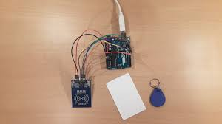
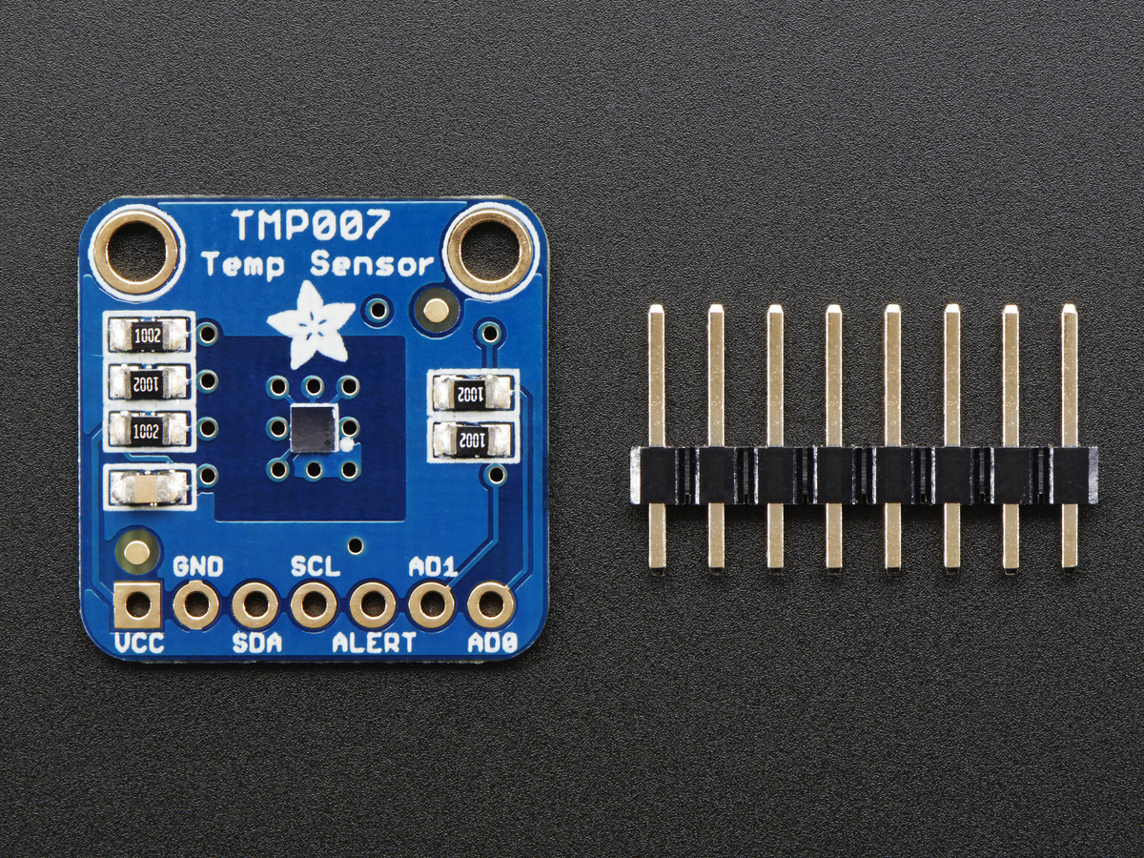
Hardware
Raspberry Pi 3
RC522 Sensor
Thermophile Sensor

Slide 3
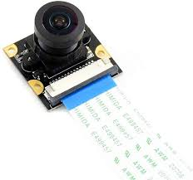
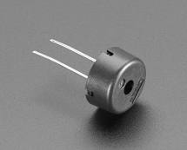
Hardware
Raspberry Pi Camera Module V2-8
Buzzer

Slide 4
Progress
So far we have completed the Face mask detection, and were planning add few more modules to the project to make it unique and useful in real world. Like mask classifier and Bu-card identification

Slide 5
Data Flow Diagram
RFID barcode data
Database
Temperature Detection
Mask Detection
Pi 3
Door Unlocked

Slide 6
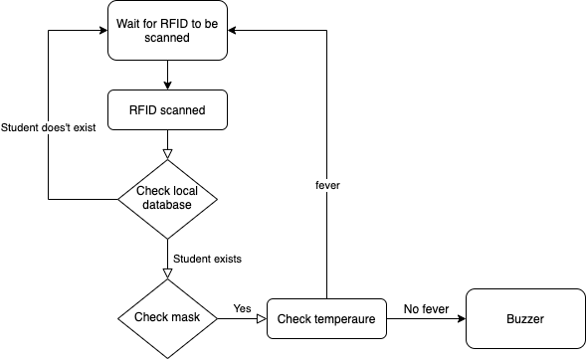
Control Flow Diagram

Slide 7
Environment / Code
Vscode, also can be done on Google Colab or Jupyter lab.
Libraries Os, tensor ,shutil, random, cv2 , numpy, sklearn
Code:
Code 1 : Model
Code 2 : Webcam / Face Detection

Slide 8
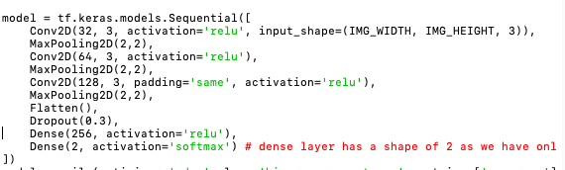
Code
Code 1 : CNN layers

Slide 9
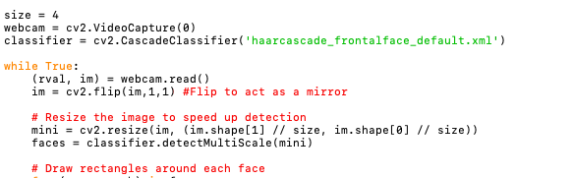
Code
Code 2 : This to turn on the Web camera and detecting face mask

Slide 10
Thank You!

